Slide 1



Hardware and Software Fundamentals of Intelligent Computing Systems

Slide 2
Lecture 43: Extreme Optimization of Heterogeneous Systems

Slide 3
Microarchitecture of Heterogeneous Systems
Architecture Evolution: From a single SIMT model toward architectures integrating tensor engines, asynchronous memory, and massive on-chip caches.
Ecosystem Differences: Fundamental differences exist in instruction throughput, register file sizes, and memory topologies across different hardware.
Optimization Requirements: Relying on abstract general-purpose compilers often leads to pipeline stalls or idle bandwidth; targeted specialization is essential.

Slide 4
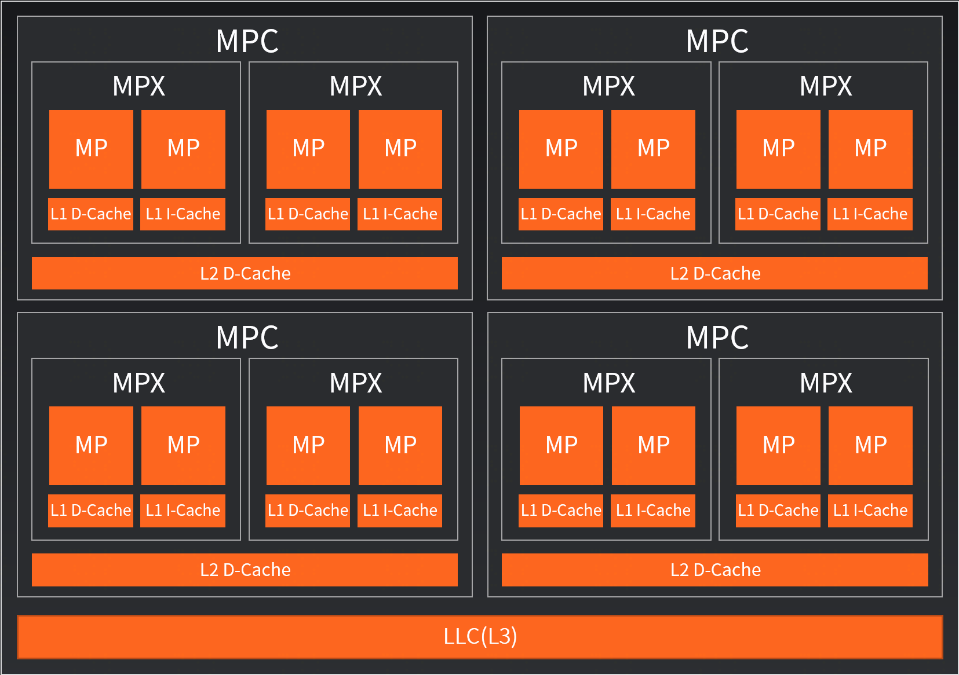
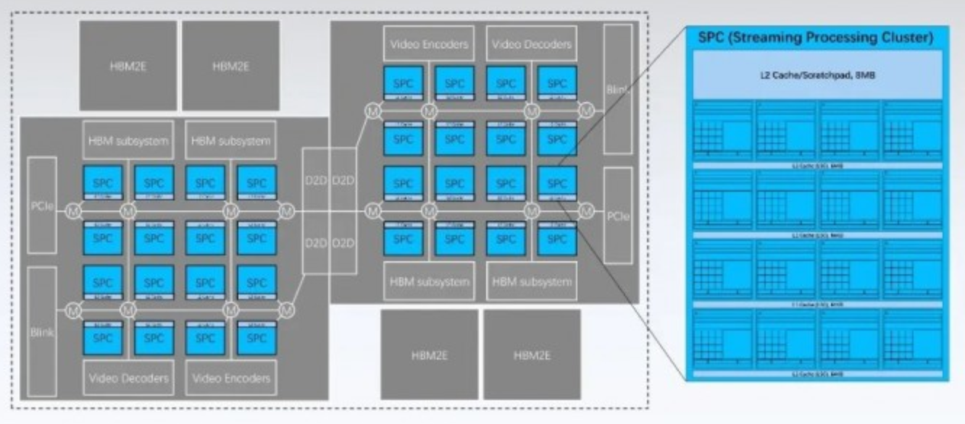
Typical Domestic GPU Microarchitecture Examples
Moore Threads (Moore Threads): Fifth-generation“Huagang” architecture, supporting next-generation asynchronous programming models and FP4 quantized data format, supporting clusters of over 100,000 cards .
Biren Technology (Biren):BR100 architecture, equipped with 300MB massive on-chip cache and 64GB HBM2E, minimizing global memory access latency to the extreme .

Slide 5
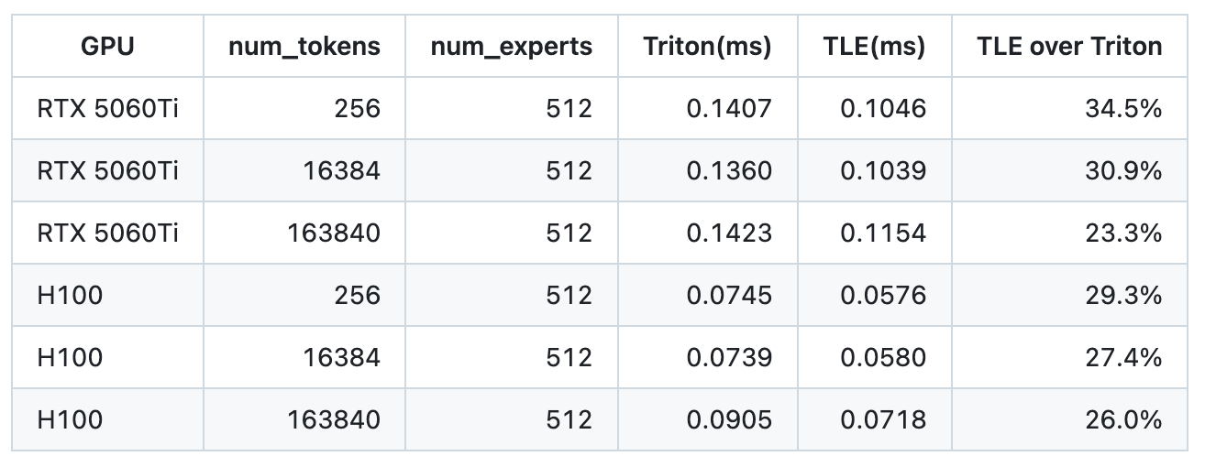
Case Study:Background and Challenges
Objective
Taking tle.gpu.local_ptr as an example, introduce how toimplement microarchitecture optimization for specific architectures
Code Location:https://github.com/flagos-ai/FlagTree/pull/333
Core Challenges
Generic optimizations cannot reach the low-level details
Shared memory access bottleneck
Significant operator performance gaps
e.g.,moe_align_block_size, topk etc.
Software stack fragmentation
https://github.com/flagos-ai/FlagTree/pull/333

Slide 6
Memory Access Optimization Fundamentals
Shared Memory Core Characteristics
Bank Structure: divided into 32 bankss, every 4 bytes spanning across banks; parallel access without conflicts
Thread Block Visible: the same CTA share it, requiring __syncthreads() for synchronization
Explicit Management:Programmer//compiler explicitly controls allocation; not a transparent cache
Domestic Chip Differences:Some domestic GPU 's bank bank width and address mapping differ from NVIDIA
local_ptr Significance: Verify via local_ptr abstraction, uniformly express shared mem pointer operations
Register
Fastest ~1 cycle
Shared Memory
Very Fast ~5 cycles, thread block shared
L1 Cache / Texture
Fast ~30 cycles
L2 Cache
Moderately Fast ~100 cycles
Global Memory (HBM)
Slow ~400+ cycles
Latency increases from top to bottom ▲

Slide 7
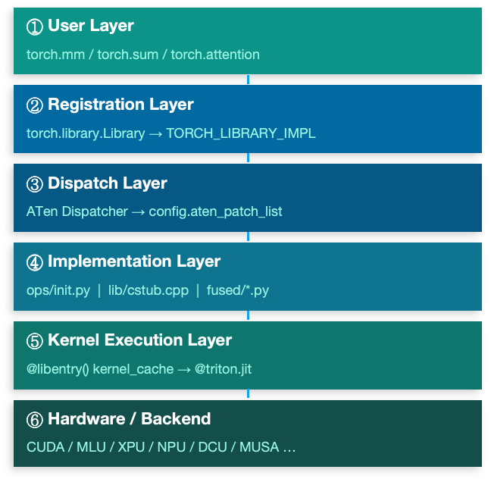
FlagGems Overview
Triton -written, Cross-Hardware Unified:
Natively supports CUDA,MLU,XPU,NPU etc. 10+ hardware backends
High-Performance Operators:
Core training and inference operators including matrix operations, attention mechanisms, normalization, and activation functions
LibEntry Kernel Cache:
In-house dispatch layer replacing Triton native Autotuner, significantly reducing first-compilation overhead and dispatch dispatch latency
Dual-Mode Deployment:
Pure Python package (quick validation) and C++ extension (production acceleration) freely switchable;C++ path eliminates Python call frame overhead
Configuration-Driven Tuning:
LibTuner automatically searches for optimal hyperparameters and persists them as YAML; cold start directly reuses them without re-running benchmark

Slide 8
FlagTree System Overview
Unified Multi-Chip AI Operator Compiler · Based on Triton & MLIR Ecosystem
Supported Chip Backends (10+ domestic and international mainstream AI chips)
NVIDIA,Cambricon,Tsingmicro,Huawei Ascend,Moore Threads, etc.
Multiple Triton version branches (v3.1 ~ v3.5) maintained in parallel; independent CI/CD
Python Frontend
Compiler Middle Layer
Backend Code Generation
Runtime Loading
@triton.jit
FlagGems LibEntry
MLIR Dialects
Triton-IR / TTGIR
LLVM-IR → PTX
ASM / Vendor Toolchain
JIT Cache
Unified HW Manager
▶
▶
▶

Slide 9
tle.gpu.local_ptr Design
FlagTree TLE Extension:Shared Memory Pointer Primitive
Core Idea: Introduce dedicated primitives at the Triton language layer so the compiler can recognize shared memory pointer operations and generate specialized instructions
Design Points
Explicitly declare operations on shared memory
Compiler-visible,lowering pass pass can recognize them
Under TLE layer provides unified definitions; each chip backend implements local_ptr 's lowering
Zero runtime overhead
# tle.gpu.local_ptr: Obtain shared memory pointer at a specified position in
def local_ptr(ptr: tl.tensor, offset: tl.tensor) -> tl.tensor:
"""
Returns a pointer to the ( GPU Shared Memory in (ptr + offset) ) location in
and tl.make_block_ptr : directly operates on raw shared memory addresses, enabling the compiler to emit architecture-specific local load/store instructions
"""

Slide 10
Compiler Pass Integration
Read from tle.gpu.local_ptr to Architecture-Specialized Instruction Transformation Pipeline
Key Pass:LocalPtrToSharedMemPass
Triton Python
Source Code
Triton IR
(TTIR)
TTGIR
(Triton GPU IR)
Specialized Pass
Processing
LLVM IR /
Target Assembly
FlagGems operator
calls local_ptr
local_ptr node
preserved in IR
Pass identifies
local_ptr node
Replaced with target architecture
local load/store
Generates optimal
memory access instruction sequence
// FlagTree: lib/Dialect/TritonGPU/Transforms/LocalPtrToSharedMem.cpp
class LocalPtrToSharedMemPass : public ...<LocalPtrToSharedMemPass> {
void runOnOperation() override {
// Traverse all tle.gpu.local_ptr operation nodes
getOperation()->walk([&](tle::gpu::LocalPtrOp op) {
// Replace local_ptr with target chip's shared memory intrinsic
rewriter.replaceOpWithNewOp<gpu::SharedMemLoadOp>(op, ...);
});
}
};

Slide 11
Pass Registration and Backend Integration
// Register Pass in backend pipeline Pass
void addPasses(PassManager &pm,
BackendType backend) {
// Common Pass
pm.addPass(createTritonGPUIRPass());
// Specialized Pass (target backend only)
if (backend == BackendType::DCU) {
pm.addPass(
createLocalPtrToSharedMemPass()
);
}
pm.addPass(createLLVMLoweringPass());
}
Optimization Results
Reduce global memory round-trip overhead
Hit shared mem bank locality
Reduce memory access latency 5~10x
Improve warp instruction-level parallelism
Pass Registration Pipeline
IR Transformation Example
%ptr = tle.gpu.local_ptr %base,
%offset : !tt.ptr<f32>
%val = tt.load %ptr : f32
// Domestic DCU architecture shared mem access
%ptr = gpu.shared_mem_ptr %base,
%offset
%val = gpu.ds_read_b32 %ptr : i32
Pass ==>

Slide 12
FlagGems Operator Layer Architecture
How to integrate local_ptr optimization into FlagGems operators
FlagGems — PyTorch ATen Operator Registration Layer
LibEntry / LibTuner — Kernel Cache and Auto-Tuning Management
Triton Kernel — Operator Implementation ( .py ) ← tle.gpu.local_ptr Injection Point
FlagTree Compiler — Specialized Pass Processing local_ptr → Architecture Instructions
Operators optimized with local_ptr (covered in PR #333)
topk
sort
argsort
median
kthvalue
mode

Slide 13
TopK Operator Optimization Case Study
local_ptr Microarchitecture Optimization in Practice
Data Proximity Storage: Store intermediate sorting results in shared memory; avoid writing back to global memory and re-reading
Bank Access Optimization: local_ptr carries offset offset information, enabling the compiler to analyze bank conflict and reorder access patterns
Instruction Fusion: Pass Replace local_ptr + load into a single ds_read instruction, reducing instruction count
Latency Hiding: shared memory dispatch latency~5 cycles;warp switching can effectively hide it, significantly improving throughput
Optimized: local_ptr Shared Memory
# local_ptr optimization: via shared memory
@triton.jit
def topk_kernel_opt(X, OUT_VAL, OUT_IDX,
BLOCK: tl.constexpr):
smem = tl.zeros([BLOCK], dtype=tl.float32)
# Use local_ptr to write to shared mem
ptr = tle.gpu.local_ptr(smem, xidx)
tl.store(ptr, tl.load(X + xidx))
tl.debug_barrier() # for synchronization
# Read from shared mem for sorting
vals = tl.load(tle.gpu.local_ptr(smem, ...))

Slide 14
FlagGems TopK Complete Optimization Path
FlagGems Registration Layer
def topk(input, k, dim=-1, largest=True, sorted=True):
...call Triton kernel...
1
src/flag_gems/ops/topk.py
Triton Kernel Layer
ptr = tle.gpu.local_ptr(shared_buf, lane_offset)
tl.store(ptr, val) # → shared mem write
2
Introduce tle.gpu.local_ptr
FlagTree Compilation
tle.gpu.local_ptr → gpu.ds_write_b32
(Domestic DCU shared memory write instruction)
3
LocalPtrToSharedMemPass Processing
Target Code Generation
ds_write_b32 v[addr], v[data]
ds_read_b32 v[out], v[addr]
4
Architecture-Optimal Instruction Sequence

Slide 15
Performance Improvement Results
Per-operator performance improvement (relative to pre-optimization, test environment: domestic DCU GPU)
topk (K=10)
+68%
~60%
~40%
topk (K=100)
+52%
TopK-class operators
Average Improvement
Sort-class operators
Average Improvement
sort (BitonicSort)
+45%
argsort
+41%
5~10x
0
median
+35%
shared mem vs.
global mem latency ratio
Code Intrusiveness
(Operator code unchanged)
kthvalue
+38%

Slide 16
Extensibility: Optimization Patterns for Other Op.s
Operator Patterns Suitable for local_ptr Optimization
Steps to Integrate New Operators with local_ptr
Intermediate Result Reuse
Step 1
Identify shared memory usage scenarios in the operator
Operators that read/write the same data multiple times internally
→ Store in shared mem to avoid multiple global accesses
Step 2
Replace tl.zeros / tl.full declared shared buffer
Inter-Warp Communication
to use tle.gpu.local_ptr references instead
Warps within the same CTA need to exchange data
→ Achieve efficient communication via shared mem
Step 3
Verify via FlagTree compilation that the Pass executes correctly
(Inspect the generated PTX / ISA)
Reduction Operations
Cross-thread reductions such as Sum / Max / Min
Step 4
Verify result correctness in the FlagGems test suite
→ Alternative to traditional shuffle
Block Sorting
Step 5
Submit PR; CI/CD automated regression testing
Bitonic sort / Radix sort block implementation
→ local_ptr keeps block data in shared mem

Slide 17

The Solution: FlagOS, a Unified AI Software Stack

Slide 18








https://space.bilibili.com/3546791834290849
https://github.com/flagos-ai
https://www.zhihu.com/people/95-22-20-18/posts
https://flagos.io/Home

Slide 19

Thanks for your time！

